Slide 1
HAYS UK SALARY & RECRUITING TRENDS 2024
hays.co.uk/salary-guide

Slide 2
WELCOME
Andrea Morgan
Business Director, North-East Credit Management Specialist
Tel: 0191 564 1662
E: andrea.morgan@hays.com

Slide 3
ABOUT OUR GUIDE
10th annual salary and recruiting trends guide
14k+ employers and employees surveyed across the UK
21 industries and sectors covered
10K+ salaries for roles across the UK
15+ insights from industry experts
Notes:
The guide is based on our survey of over 14,500 employers and employees from across the UK. We received responses from a broad range of sectors, levels of seniority and size of organisation. Our research also received responses from professionals across a range of age groups, allowing us to take a deeper dive into what matters most to employees at different stages of their lives when it comes to their job.
The guide also takes a closer look at hiring trends across 21 different industries and sectors and contains over 10,000 salaries for roles across the UK and market insights from over 15 industry experts.

Slide 4
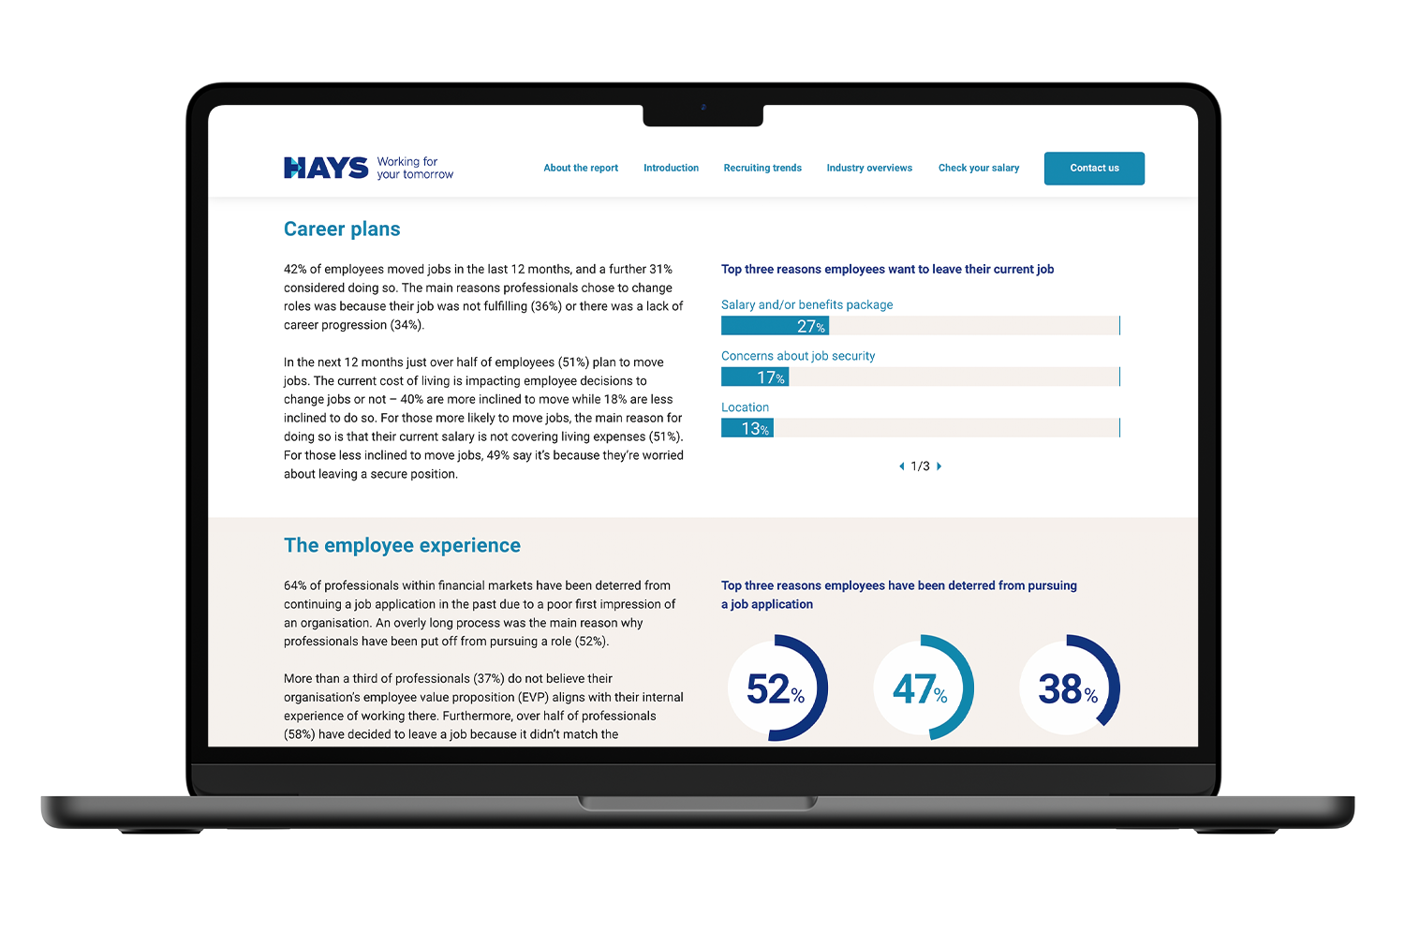
WHAT’S IN THIS YEAR’S GUIDE?
10-year employment trends
Employment outlook
Cost of living vs cost of staying
Upskilling for the future
Ways of working: Getting the balance right
AI in the workplace
The employee experience
Intergenerational working
Notes:
The last year has been full of challenges and opportunities, from increases in the cost of living and inflationary pressures, through to the rise of new tech such as more accessible AI tools like ChatGPT.
Our 2024 Salary & Recruiting Trends guide goes into much more detail on these topics and more. I’ll take you through a snapshot of some of the key findings now.

Slide 5
EMPLOYMENT OUTLOOK
Top external challenge this year:
Top internal challenge this year:
Hiring plans:
52%
61%
77%
Recruiting the right talent
Talent retention
plan to hire in the next 12 months
Notes:
To get a gauge of the outlook on the employment market, we asked employers what challenges they expect to face in the year ahead. Responses ranged from talent management through to keeping up with technology innovation. For employers across the UK, the biggest expected external challenge is being able to recruit the right talent, while internally they expect to face difficulties retaining talent.
Hiring plans remain busy – 77% of employers across the UK expect to recruit in the next 12 months.

Slide 6
COST OF LIVING VS COST OF STAYING
3.5%
Professions with the highest salary increase last year:
Sustainability 6.3%
Accountancy and finance 5.6%
Procurement 5.1%
Legal 4.9%
Supply chain and logistics 4.7%
average salary increase across the UK over the last year
Notes:
The rising cost of living over the last year has resulted in many employers increasing the pay of their staff. Across the UK, salaries rose by an average of 3.5%.
Some professions where demand is highest received above average pay rises over the last year, for example within sustainability (6.3%), accountancy and finance (5.6%) and procurement (5.1%).
[note to speaker – opportunity here to add in your own insights about in-demand areas and pay rises for your region/area of expertise]

Slide 7
COST OF LIVING VS COST OF STAYING
Is the current cost of living affecting employee decisions to move job?
52%
of employees plan to move jobs in the next 12 months
Notes:
52% of employees across the UK plan to move jobs in the year ahead.
The rising cost of living has impacted on employee decisions to move jobs. 42% of employees are more inclined to move jobs due to the rise in the cost of living because their current salary doesn’t cover their living expenses. On the other hand, 17% are less inclined to want to move jobs because they’re worried about things such as job security.

Slide 8
UPSKILLING FOR THE FUTURE
What would employees prefer their employer offered to help them upskill?
Notes:
Skills shortages are still being widely felt – 92% of employers across the UK have faced skills shortages over the last year almost no change from the year before (93%).
As employers continue to struggle to find and retain individuals with the right skillsets, organisations must consider a broad range of options to set themselves up for success not only for today, but also for the future. For example, employers can consider actively hiring certain individuals to help alleviate skills gaps, for example, graduates, over 50s, workers from other industries or professions or those from disadvantaged socio-economic backgrounds.
Being less focused on specific skills and experience when hiring can also help employers to overcome skills shortages. Our research shows that 80% of UK employers would be likely to hire a professional lacking all the required skills with the intention of upskilling them, and a further 73% believe an individual’s willingness to learn is more important than their existing skillset.
To help them upskill, employees would prefer that their employer invested in training, allowed time during working hours to complete training and attend relevant conferences or talks, and also provide access to online training tools.

Slide 9
WAYS OF WORKING: GETTING THE BALANCE RIGHT
Steps employees want their organisation to take to enable equal experiences wherever someone is based
64%
53%
52%
Build a culture where employees feel safe sharing their views on ways of working
Regularly celebrate employee achievements
Ensure managers are trained to manage hybrid teams
Notes:
Where possible, hybrid working is a crucial factor for employee attraction and retention. There’s still work to do to strike the right balance and to best support staff whether they’re based at home, in the workplace or straddling both.
Across the UK, 61% of employers offer hybrid working to their staff. 43% of employees would not consider accepting a job in the future that didn’t offer hybrid working.
To strike the right balance for hybrid working, employees want their organisation to build a culture where employees feel safe sharing their views on ways of working, to regularly celebrate employee achievements regardless of where they’re working, and to ensure that managers are properly trained to manage hybrid teams.

Slide 10
AI IN THE WORKPLACE
60%
of employees don’t think their employer is helping them prepare to use AI in the workplace
Notes:
In recent months, easy-to-use artificial intelligence, tools and technologies like ChatGPT have made AI more accessible to the masses.
Only just over a quarter of employers across the UK (27%) say their organisation is currently using AI tools, but 71% expect AI tools will be used in the future.
36% of employees think they only have some of the skills they need to use AI to its best potential, and a further 26% don’t think they have any of the right skills. Despite this, 60% of employees do not think their employer is helping them to prepare for the use of AI in the workplace.
Our recent 2023 What Workers Want: AI in the Workplace report goes into more detail about how employers can best support their staff in making the most of AI tools, you can download a copy on our website.

Slide 11
THE EMPLOYEE EXPERIENCE
Reasons employees have been deterred from pursuing a job application
Notes:
It’s a highly competitive recruiting market at the moment. Providing a positive employee experience to attract and retain staff is therefore more important than ever before.
An employee’s experience within your organisation runs all the way from initial contact via the job application process, through to their time working with you and even up until their last day and exit interview. However, 64% of employees say they have been deterred from continuing with a job application process because of a poor first impression of an organisation.
Furthermore, 45% of employees say they have left a job because it didn’t match the expectations gained during the application process.

Slide 12
ATTRACTING & RETAINING TALENT
Top three aspects of a role that make it more appealing to candidates considering a new position
67%
62%
52%
Job security
An engaging and supportive team culture
Tailored flexible working policies
Notes:
So, what makes a role more appealing to candidates? Employees look for job security, an engaging and supportive team culture and tailored flexible working practices. Professionals also want to see an organisation’s purpose and commitment to sustainability when assessing a new role.
All of this contributes to your employee value proposition, or EVP. A good employee value proposition (EVP) is a clear and consistent message about the experience of working at your organisation to help employees understand what’s best about working for you. However, nearly two-fifths of employees (38%) don’t believe their current organisation’s EVP aligns with their own experiences working there.

Slide 13
ACCESS THE FULL FINDINGS
hays.co.uk/salary-guide
Notes:
That’s just some of the findings from our 2024 UK Salary & Recruiting Trends guide. The guide itself contains lots more information including our 10-year lookback at key hiring trends and a closer look at how to best support and engage with your intergenerational workforce.
To access the full findings, visit hays.co.uk/salary-guide.
If you have any questions or want to discuss how the findings impact your hiring plans for the year ahead, please reach out to your Hays consultant.

Slide 14
Now we will focus more on the credit market.

Slide 15
INSIGHTS REPORT
Prepared for
CREDIT MANAGEMENT WEBINAR
APRIL 2024

Slide 16
TALENT INSIGHTS
Presented by Andrea Morgan
Business Director, Hays Specialist Recruitment

Slide 17
GLOSSARY
SUPPLY COUNT The number of candidates in the stated location who match the job title & search criteria provided on their online profile, evidencing supply.
LIVE JOB COUNT
The number of live job advertisements that match the search criteria in the stated location on the date the data was produced, evidencing demand.
CANDIDATE SUPPLY RELATIVE TO DEMAND
The number of candidates (supply count) divided by the number of live job advertisements (live job count), i.e. candidates per role
AVERAGE SALARY
The average salary advertised for candidates based on live job advertisements that contribute to the live job count; excluding bonuses/commission.
LOWER QUARTILE The value that has 25% of the data below it and the top 75% above it.
UPPER QUARTILE The value that has 75% of the data below it and the top 25% above it.
GENDER The gender breakdown within the supply count in the stated location.
ETHNICITY The ethnicity breakdown within the supply count in the stated location.
EXPERIENCE The years of experience breakdown within the supply count in the stated location.

Slide 18
CREDIT MANAGER

Slide 19
TALENT INSIGHTS DASHBOARD CREDIT MANAGER - DURHAM (50 MILES)
SUPPLY COUNT
680
LIVE JOB COUNT
2
SALARY EXPECTATIONS
KEY TAKEAWAYS
There is a very high candidate supply in relation to demand, with 340 suitable candidates per job advertisement.
The talent pool for Credit Manager within a 50-mile radius of Durham exhibits low ethnic diversity, with White ethnicity comprising over 92% and Asian and Other ethnicities making less than 8% of the total talent pool
The talent pool’s gender distribution is predominantly male population with 44% of the total talent pool being female
69% of the talent pool have 8+ years of experience, so it is to be expected that this percentage of the talent pool would expect pay in the upper quartile.​The talent pool is experienced. Only 15% of the total talent pool has less than 3 years of experience
CANDIDATE SUPPLY RELATIVE TO DEMAND
Low
High
340
GENDER
ETHNICITY
EXPERIENCE
MALE
FEMALE

Slide 20
ASSOCIATED JOB TITLES
CREDIT MANAGER
ALTERNATIVE JOB TITLES
Credit Controller | Senior Collections Manager
Account Manager | Senior Credit Controller
Credit Manager | Senior Credit Analyst
Senior Credit Controller | AR Manager
Collections Advisor | Accounts Payable Manager
Collections Manager | Accounts Receivable Manager
Accounts Assistant | Credit Analyst

Slide 21
SUPPLY AND DEMAND – BREAKDOWN BY LOCATION CREDIT MANAGER - DURHAM (50 MILES)
KEY TAKEAWAYS
Durham has the highest number of suitable candidates per role (321) making it the best source for this talent
Newcastle upon tyne, Darlington and Sunderland have a good number of suitable candidates, 137, 94 and 66, respectively and no job opportunities making them potential sources for candidates open to travel due to the lack of local opportunities.​ ​

Slide 22
COMPETITOR INSIGHTS CREDIT MANAGER - DURHAM (50 MILES)
ORGANISATIONS CANDIDATES WORK FOR
ORGANISATIONS WHO FREQUENTLY ADVERTISE THIS ROLE
Where do you look for talent?
Who are you competing against?
Procter & gamble
EE
Barclays
Barclays Bank
HSBC
Sage
Balfour Beatty
Barclaycard
Lloyds Banking Group
Newcastle Building Society
Virgin Money
Durham University
Northgate Vehicle Hire
Orange
Rwe Npower
Santander
BT
Hsbc Commercial Banking
Nike
Hays Specialist Recruitment
TT Electronics

Slide 23
SKILLS IN DEMAND CREDIT MANAGER - DURHAM (50 MILES)
TOP IT SKILLS
Data Analysis
Data Integrity
Query Optimization
SQL Databases
Office Suite
Power BI
Technical Data Management Systems
TOP PROFESSIONAL SKILLS
Sales
Credit Risks
Calculations
Consulting
Credit Control
Credit Management
Project Management
Risk Analysis
Risk Management
TOP SOFT SKILLS
Communication Skills
Leadership
Problem Solving
Attention to Details
Team Working
Adaptability
Analytical Thinking

Slide 24
CREDIT CONTROL

Slide 25
TALENT INSIGHTS DASHBOARD CREDIT CONTROL - DURHAM (50 MILES)
SUPPLY COUNT
3,838
LIVE JOB COUNT
1,240
SALARY EXPECTATIONS
KEY TAKEAWAYS
There is a very low candidate supply in relation to demand, with only 3 suitable candidates per job advertisement.
The talent pool for Credit Control within a 50-mile radius of Durham exhibits low ethnic diversity, with White ethnicity comprising over 92% and Asian, Black and Other ethnicities making less than 8% of the total talent pool
The talent pool’s gender distribution is an almost equal gender split with with 46% of the total talent pool being male
66% of the talent pool have 8+ years of experience, so it is to be expected that this percentage of the talent pool would expect pay in the upper quartile.​The talent pool is experienced. Only 14% of the total talent pool has less than 3 years of experience
CANDIDATE SUPPLY RELATIVE TO DEMAND
Low
High
3
GENDER
ETHNICITY
EXPERIENCE
MALE
FEMALE

Slide 26
ASSOCIATED JOB TITLES
CREDIT CONTROL
ALTERNATIVE JOB TITLES
Accounts Assistants | Finance Manager
Credit Controller | Finance Officer
Accounts Manager | Finance Administrator
Purchase Ledger Clerk | Credit Control Administrator
Assistant Accountant | Credit Control Manager
Management Accountant | Service Desk Analyst
Financial Controller

Slide 27
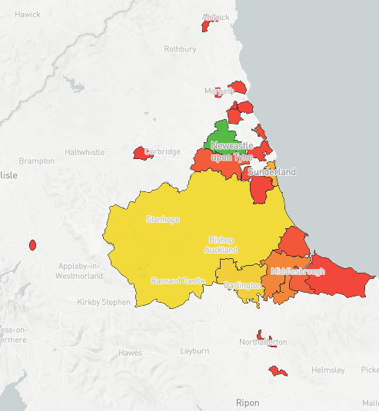
SUPPLY AND DEMAND – BREAKDOWN BY LOCATION CREDIT CONTROL - DURHAM (50 MILES)
KEY TAKEAWAYS
Newcastle has the highest number of suitable candidates (1,480) making it a good location to engage with candidates. However, it has 305 live vacancies, meaning there will be competition from other employers in this location.
Sunderland District has the highest number of suitable candidates per role (16) making it a good location to engage with talent.

Slide 28
COMPETITOR INSIGHTS CREDIT CONTROL - DURHAM (50 MILES)
ORGANISATIONS CANDIDATES WORK FOR
ORGANISATIONS WHO FREQUENTLY ADVERTISE THIS ROLE
Where do you look for talent?
Who are you competing against?
Sage
Procter & gamble
EE
HM Revenue & Customs
BT
Northumbria University
Newcastle University
Barclays
Accenture
Northgate
Balfour Beatty
Orange
Virgin Money
Durham County Council
Hewlett Packard Enterprise
Northgate Vehicle Hire
Durham University
DXC Technology
Hays Travel
Jackson Hogg
Hays Specialist Recruitment
Elm Alliance Ltd
Ministry Of Defence (defence Medical Services)
Nigel Wright
EY
Priory Healthcare
Sytner Group
Reed
Redde Northgate Plc
Balfour Beatty
BMC Recruitment Group
Vertu Motors
Barchester Healthcare
Mowbray House Surgery
Railway Medical Group
DAC Beachcroft
Alpha Language Services
KCR Solutions

Slide 29
SKILLS IN DEMAND CREDIT CONTROL - DURHAM (50 MILES)
TOP IT SKILLS
Microsoft Excel
Microsoft Windows
Computer Literacy
Microsoft Office
Microsoft Word
Accounting Systems
Data Transmissions
TOP PROFESSIONAL SKILLS
Credit Control
Knowledge of Finance
Accounts Receivable
Accounting
Balance Sheets
Cash Management
Accounts Payable
Customer Relationship Management
Knowledge of Mathematics
TOP SOFT SKILLS
Communications Skills
Self Motivations
Attention to Detail
Management of Stress
Team Working
Analytical Thinking
Interpersonal Skills
Problem Solving
TOP LANGUAGE SKILLS
English

Slide 30
CREDIT ANALYST

Slide 31
TALENT INSIGHTS DASHBOARD CREDIT ANALYST - DURHAM (50 MILES)
SUPPLY COUNT
336
LIVE JOB COUNT
10
SALARY EXPECTATIONS
KEY TAKEAWAYS
There is a low candidate supply in relation to demand, with 34 suitable candidates per job advertisement.
The talent pool for Credit Analyst within a 50-mile radius of Durham exhibits very low ethnic diversity, with White ethnicity comprising over 95% and Asian and Other ethnicities making less than 5% of the total talent pool
The talent pool’s gender distribution is predominantly male population with 29% of the total talent pool being female
66% of the talent pool have 8+ years of experience, so it is to be expected that this percentage of the talent pool would expect pay in the upper quartile.​The talent pool is experienced. Only 19% of the total talent pool has less than 3 years of experience
CANDIDATE SUPPLY RELATIVE TO DEMAND
Low
High
34
GENDER
ETHNICITY
EXPERIENCE
MALE
FEMALE

Slide 32
ASSOCIATED JOB TITLES
CREDIT ANALYST
ALTERNATIVE JOB TITLES
Credit Manager | Financial Controller
Credit Analyst | Fraud And Risk Executive
Credit Controller
Senior Associate
Accountant
Credit Risk Manager
Finance Specialist

Slide 33
SUPPLY AND DEMAND – BREAKDOWN BY LOCATION CREDIT ANALYST - DURHAM (50 MILES)
KEY TAKEAWAYS
Durham has the highest number of suitable candidates per role (5) making it the best source for this talent
Newcastle upon tyne, Darlington, Sunderland and Stockon-on-tees have a good number of suitable candidates, 202, 43, 27 and 11, respectively and no job opportunities making them potential sources for candidates open to travel due to the lack of local opportunities.

Slide 34
SKILLS IN DEMAND CREDIT ANALYST - DURHAM (50 MILES)
TOP IT SKILLS
Databases
Microsoft Excel
Microsoft Word
Microsoft Outlook
TOP PROFESSIONAL SKILLS
Knowledge of Finance
Accounts Receivable
Accounting
Auditing Skills
Financial Underwriting
Business to Business Commerce
Balance Sheets
Business Informatics
Business Process Improvement
TOP SOFT SKILLS
Communication Skills
Team Working
Management of Stress
Passionate
Coordination Skills
Attention to detail
Forward-Thinking
Process Oriented Person

Slide 35
RECOMMENDATIONS
Make your salary and benefits package as attractive as possible
DE & I - Diversity, equity and inclusion policy
Upskill for the future
Get the balance right with different ways of working
Bring your staff along your AI journey
Create an employee experience worth staying for
Have a strong employee value proposition (EVP)
Understand your intergenerational workforce
Notes:
Make your salary and benefits package as attractive as possible: The rise in the cost of living is making a better pay and benefits package the ultimate motivator for many employees seeking a new job. Our analytics and insights service leverages bespoke and independent reporting that contains real-time data and recommendations for you to create the best remuneration strategy. Find out more: https://www.hays.co.uk/advisory-services/salary-benchmarking
Upskill for the future: The skills that organisations need continue to rapidly evolve. Taking steps such as hiring for potential rather than for specific skillsets or experience can help employers to broaden their pool of talent. Organisations should also foster a culture of continuous learning through investment in training, offering mentorships and reverse mentorships to staff, encouraging uptake of upskilling opportunities to all and allowing time to undertake training or attend relevant conferences during working hours. Our new service of Skills and Learning can also help organisations mitigate the widening skills gap through creating new talent and generating opportunities for undiscovered talent. Find out more https://www.hays.co.uk/recruitment-services/hays-skills
Get the balance right with different ways of working: Listening to your staff and facilitating wherever possible to their working preferences can help to improve productivity. Creating a wider range of spaces to better facilitate hybrid working. Take steps to make everyone feel supported through transparency and proper training.
Bring your staff along your AI journey: Many employers believe their organisation will be using AI at some point in the future. Help your team to be prepared for the changes ahead by keeping them updated with how you plan to use AI tools, the benefits they’ll bring, be honest about whether usage will be monitored and set expectations on how you want your staff to use AI at work. Read our 2023 What Workers Want: Working with AI report for further insights and recommendations.
Create an employee experience worth staying for: Streamline your hiring processes and give feedback to candidates wherever possible. Promote your employee value proposition (EVP) throughout the recruitment process and make sure you also showcase your organisation’s purpose and sustainability credentials. Our Solutions business provides a range of tailored services built around the candidate experience. Find out more, visit https://www.hays.co.uk/advisory-services
Understand your intergenerational workforce: One size doesn’t fit all when it comes to what professionals from different age groups value and want from a role. Observe how each generation works best and what matters to professionals of different generations and consider what your organisation can offer to meet the needs and demands of all your employees, making sure any opportunities or benefits are communicated effectively. Read our 2023 What Workers Want: Older Workers report and our 2023 Diversity, Equity & Inclusion report for more insights.

Slide 36
ACCESS THE FULL FINDINGS
hays.co.uk/salary-guide/digital-guide
Notes:
That’s just some of the findings from our 2024 UK Salary & Recruiting Trends guide. The guide itself contains lots more information including our 10-year lookback at key hiring trends and a closer look at how to best support and engage with your intergenerational workforce.
​
To access the full findings, visit hays.co.uk/salary-guide/digital-guide.
​
If you have any questions or want to discuss how the findings impact your hiring plans for the year ahead, please reach out to your Hays consultant.

Slide 37
THANK YOU! Any questions?

